Slide 1

NETFLIX MOVIE GROUP CLUSTERING
Jeffrey Mao

Slide 2

There are so many movie categories on Netflix

Slide 3
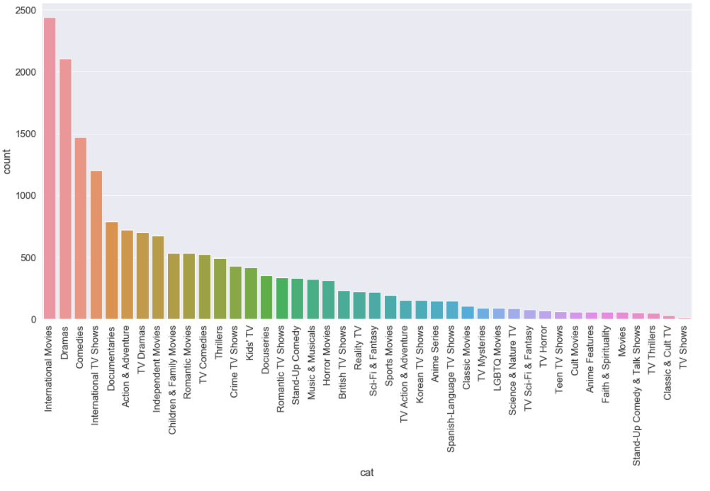
Count of Movie Categories

Slide 4

The goal of this project is to identify distinct movie categories based on movie description.

Slide 5
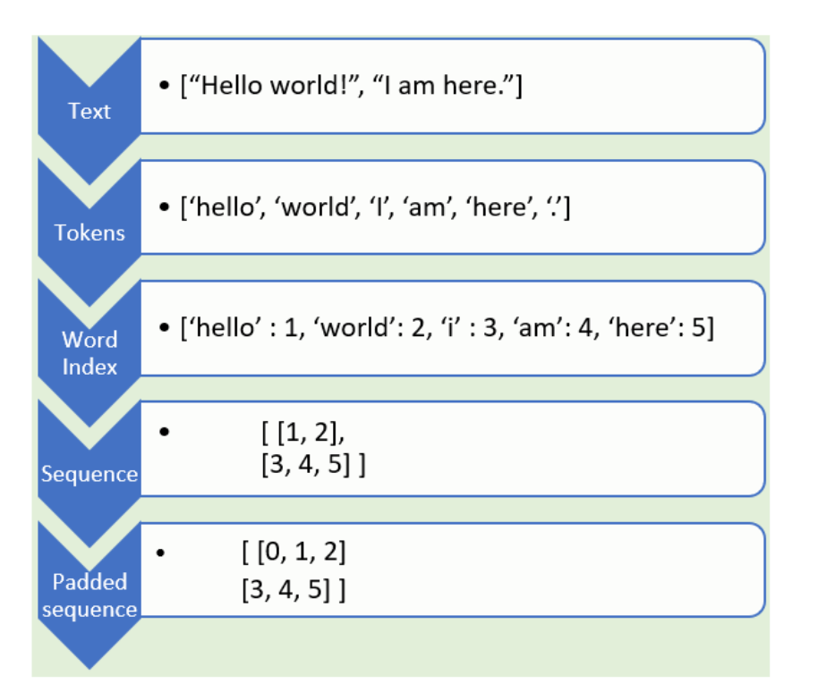
Tokenzation
Split up movie description text into words.
Transform each text to a sequence of integers.

Slide 6
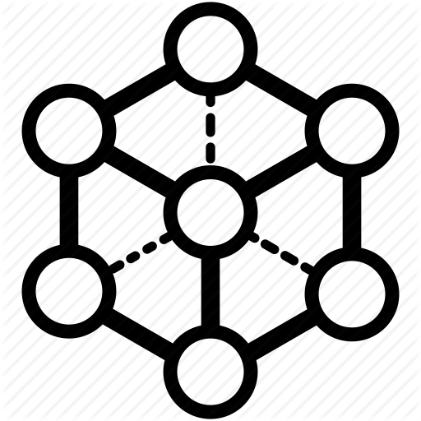


Deep Learning
LSTM
GRU

Slide 7
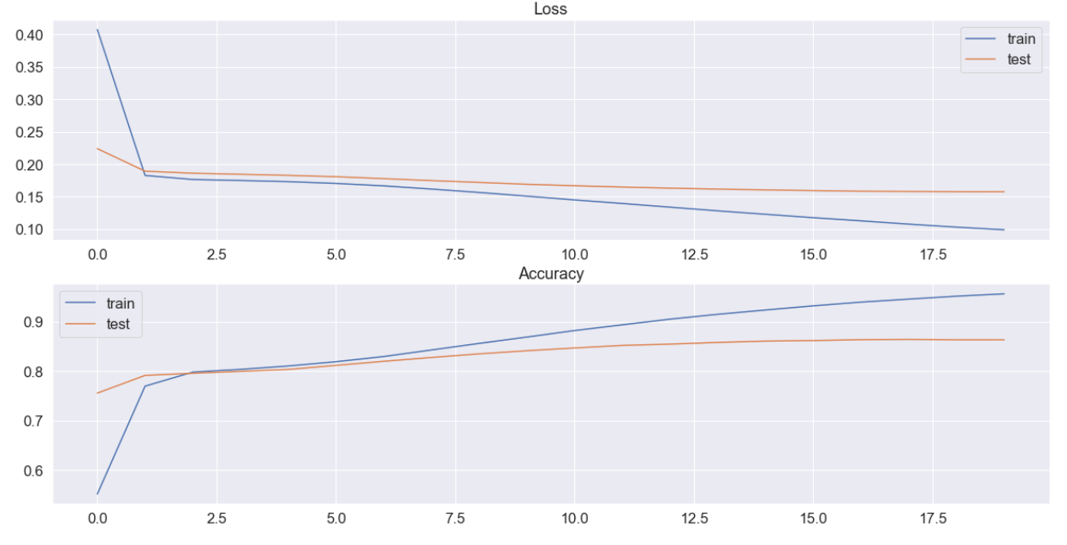
DNN ACCURACY RESULTS
Training Set Accuracy: 94.65%
Test Set Accuracy: 87.1%

Slide 8
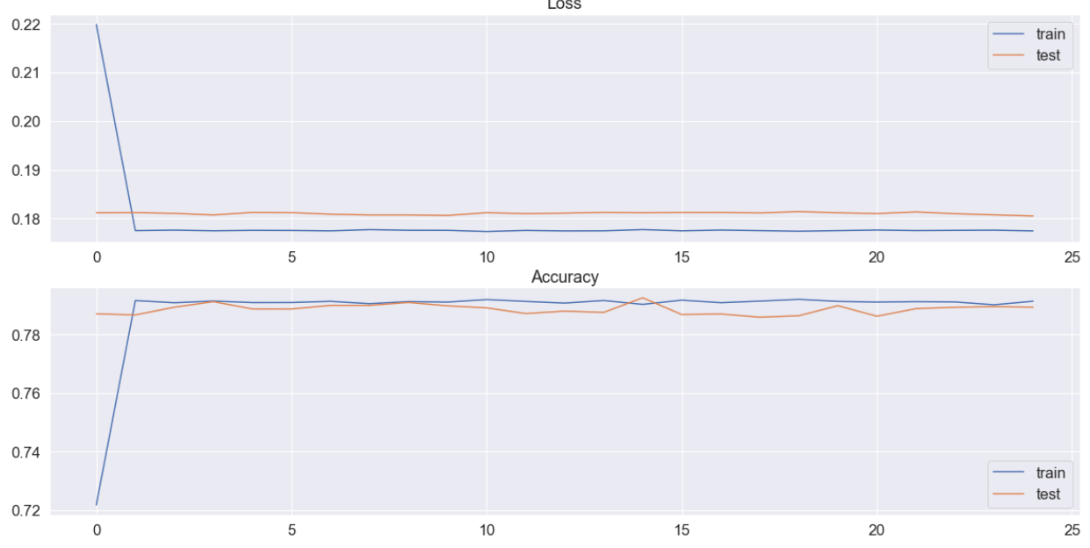
LSTM ACCURACY RESULTS
Training Set Accuracy: 79.17%
Test Set Accuracy: 79.6%

Slide 9
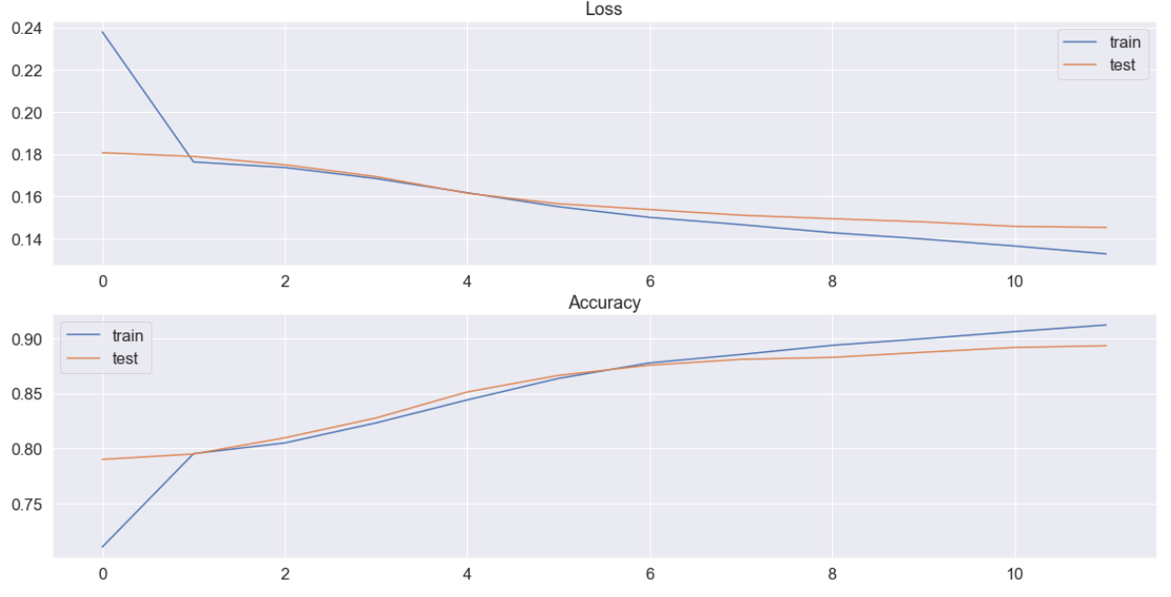
GRU ACCURACY RESULTS
Training Set Accuracy: 91.3%
Test Set Accuracy: 83.2%

Slide 10
ADDITIONAL SUGGUSTIONS
Increase the number of epoch
Increase the number of layers
Use resampling, under-sampling or over-sampling method to make data balanced.

Slide 11
Thank you

